Slide 1
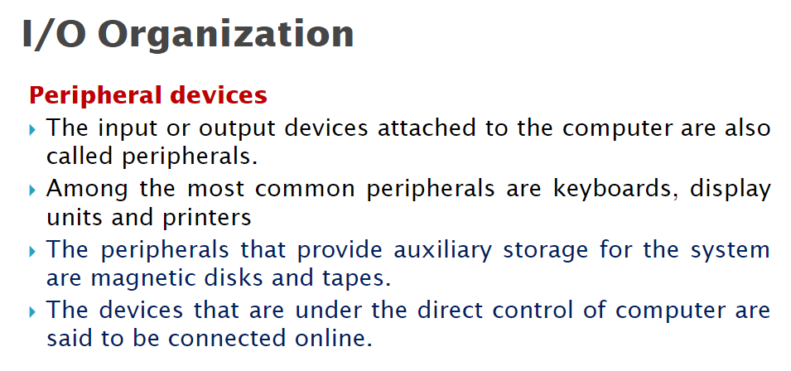

Slide 2
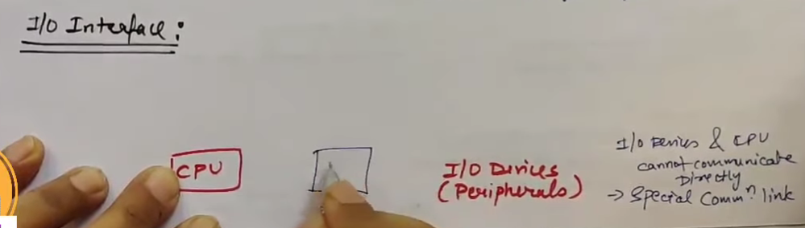
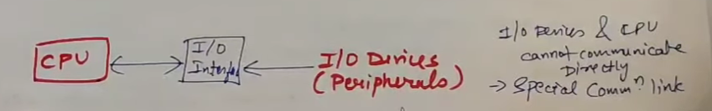

Slide 3
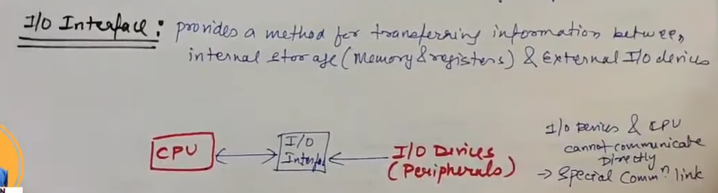
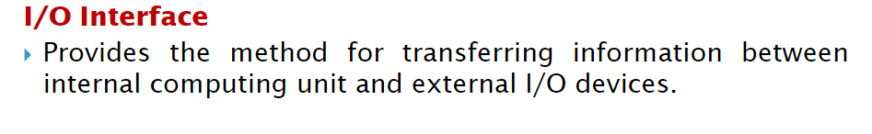

Slide 4
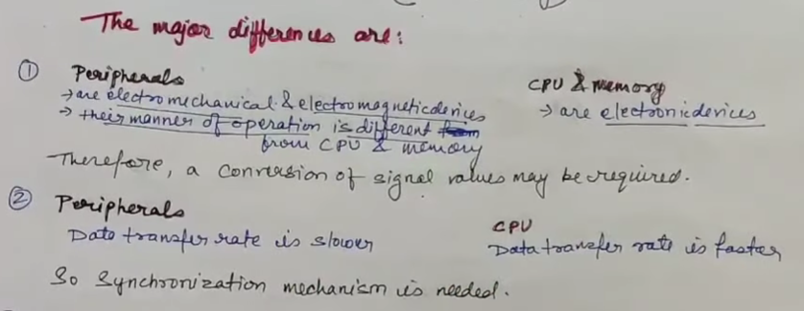
So we need to remove or resolve these difference that’s why we use special kind of hardware

Slide 5
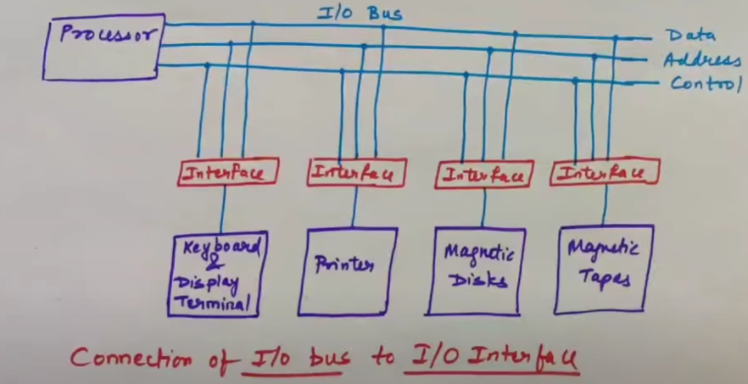
Periopherals are not directly connected to hardware cause difference
That’s why came interface

Slide 6
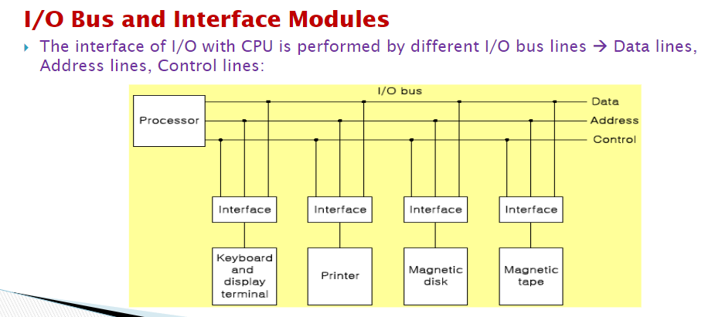

Slide 7
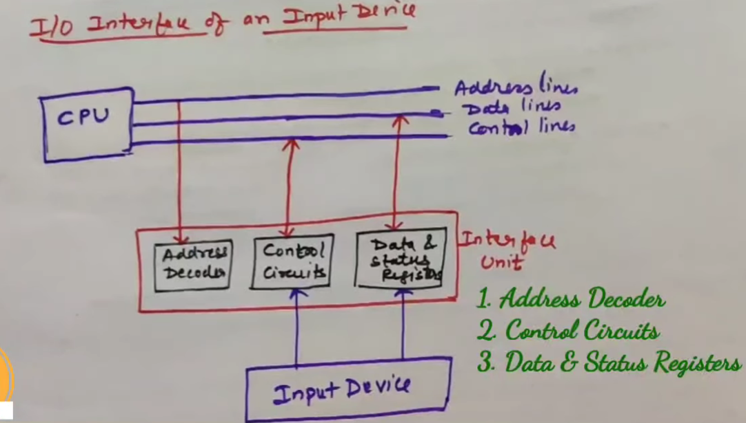

Slide 8
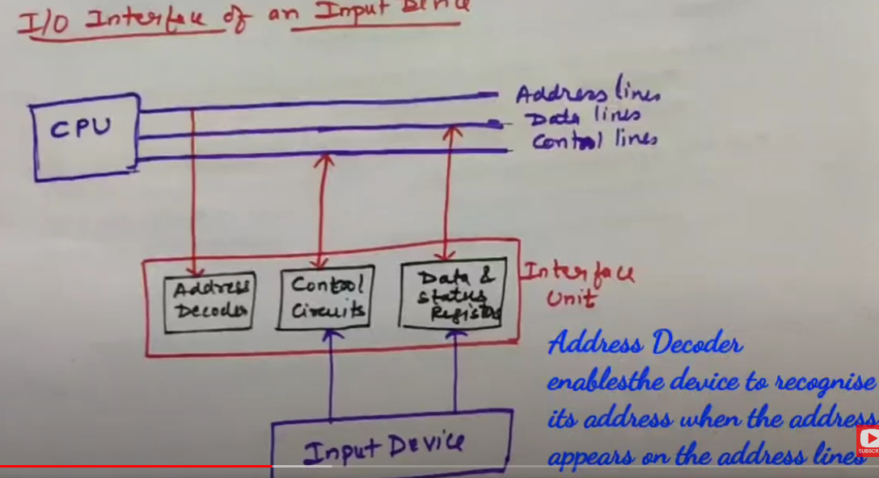

Slide 9
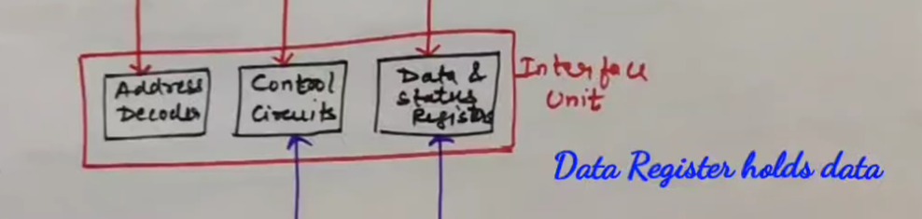
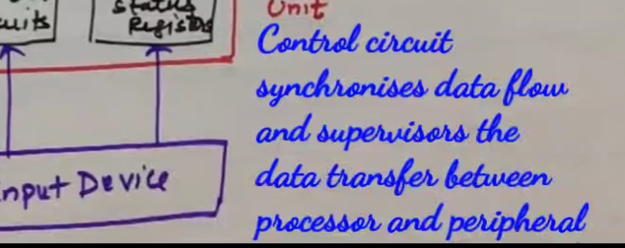

Slide 10
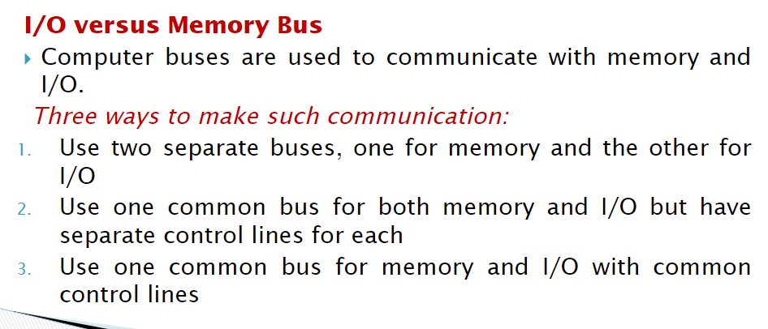

Slide 11
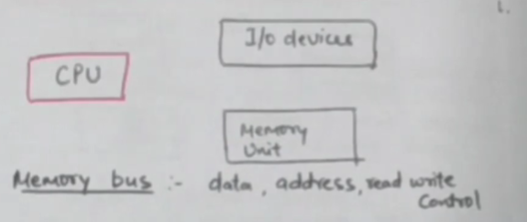

Slide 12
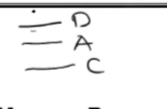
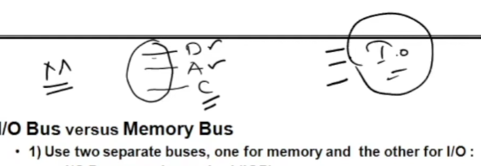
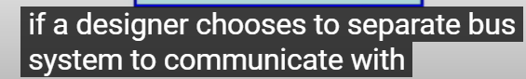


Slide 13
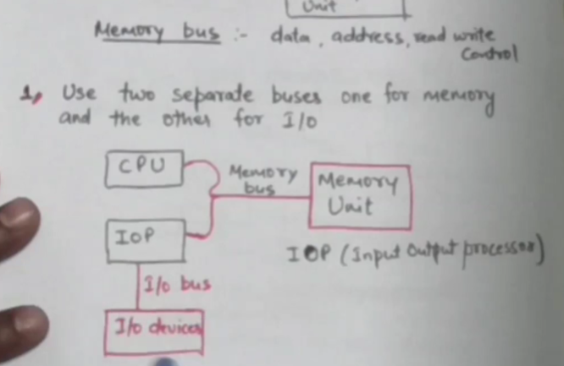

Slide 14
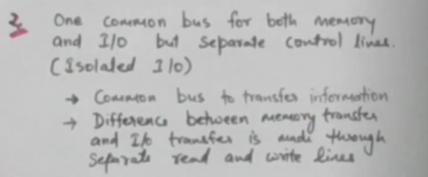

Slide 15
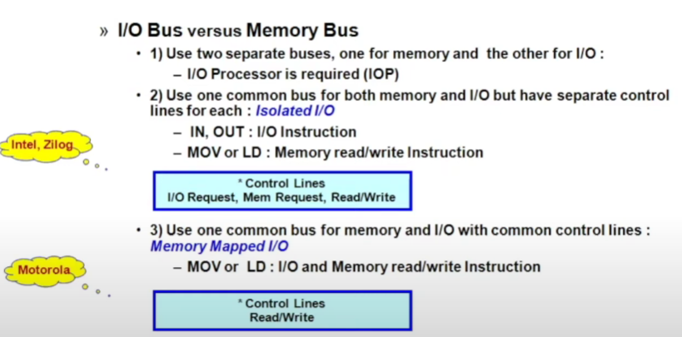

Slide 16
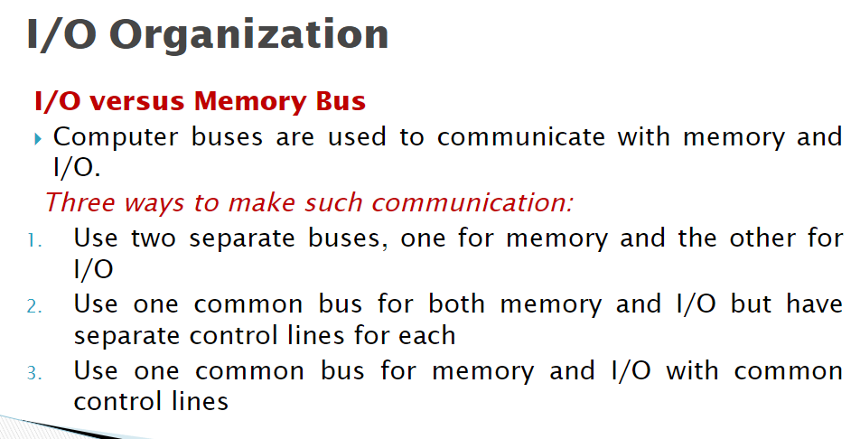

Slide 17
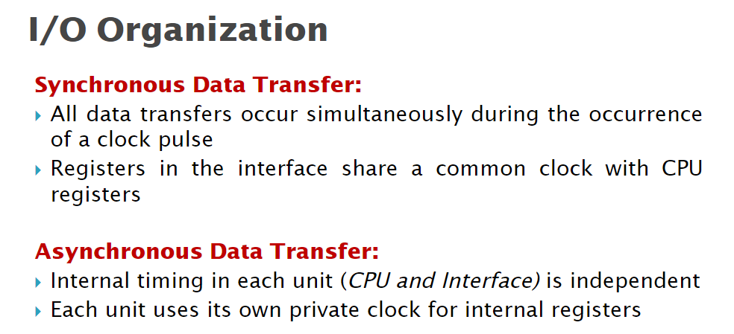

Slide 18
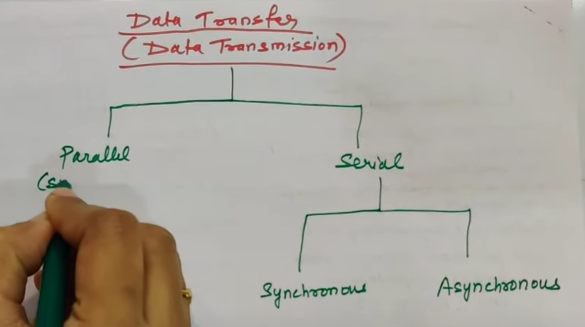

Slide 19
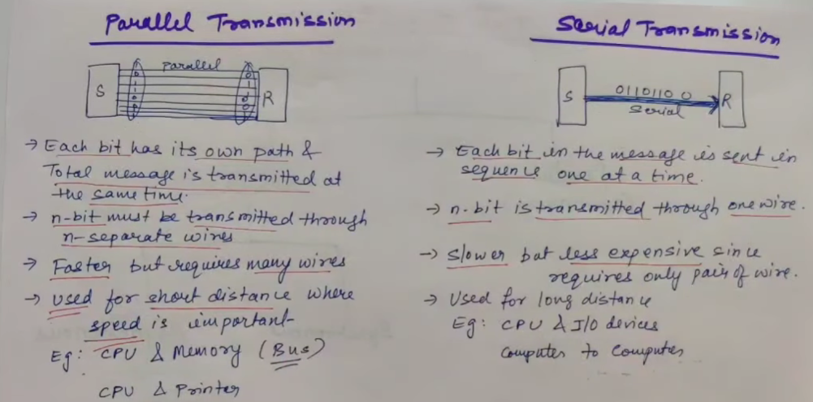

Slide 20
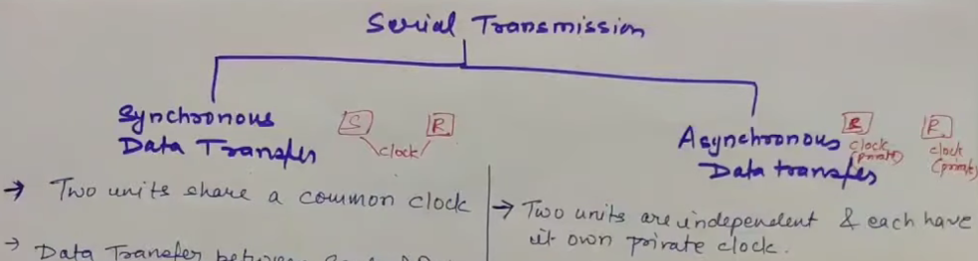

Slide 21
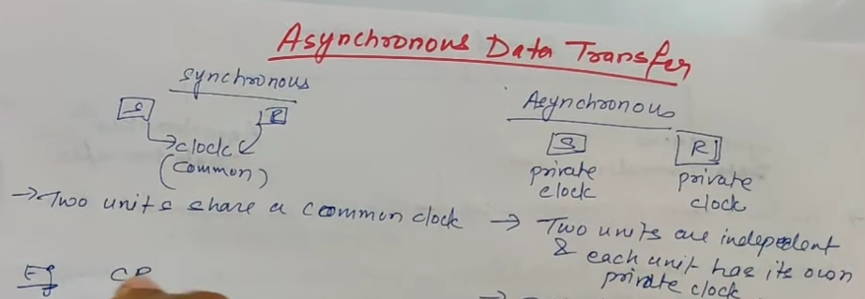

Slide 22
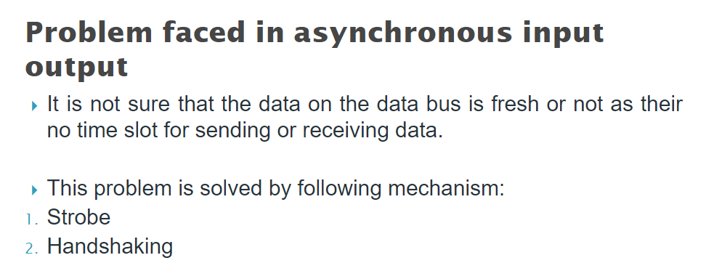

Slide 23
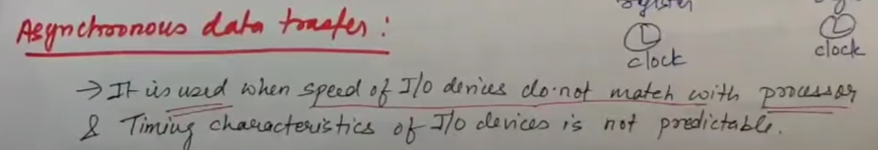
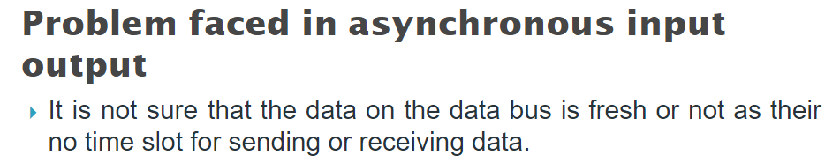

Slide 24
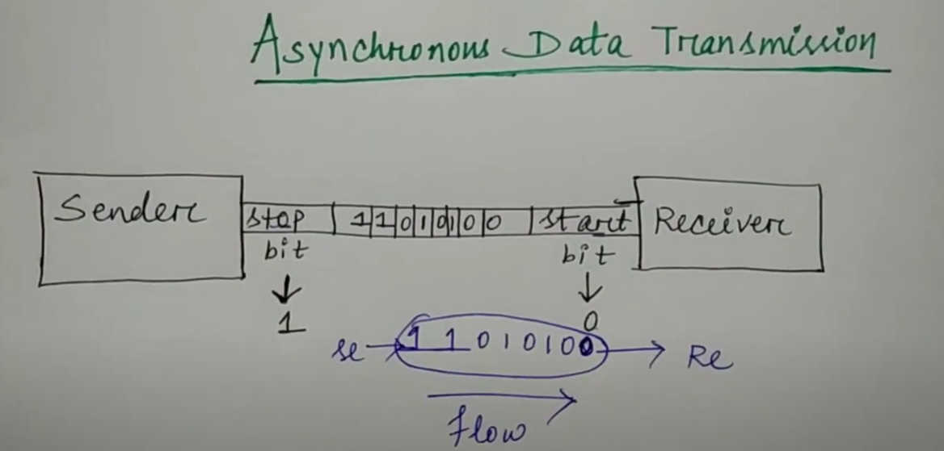

Slide 25
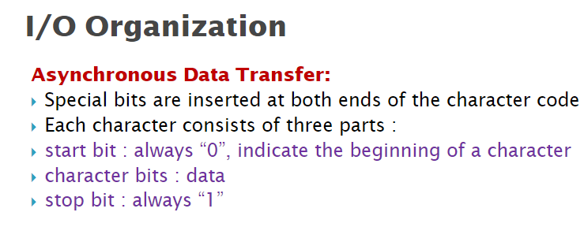

Slide 26
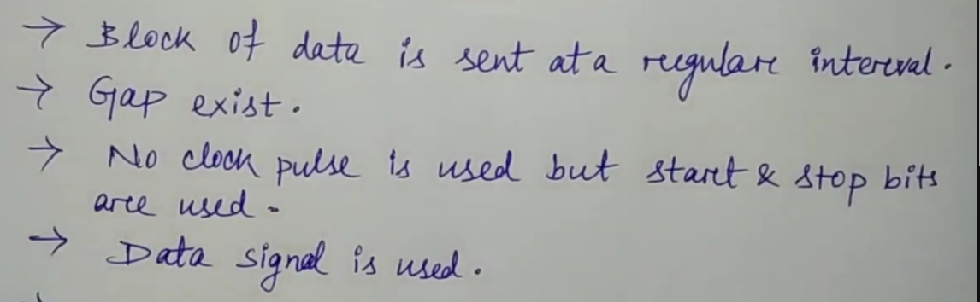

Slide 27
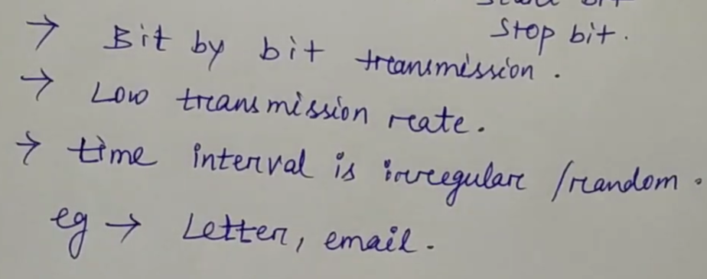

Slide 28
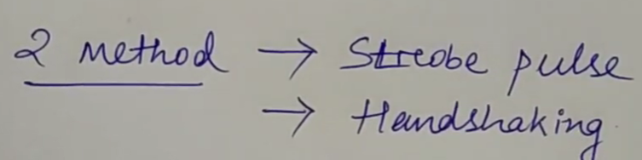
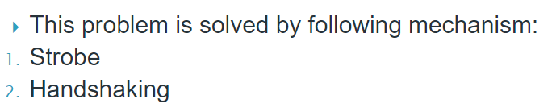

Slide 29
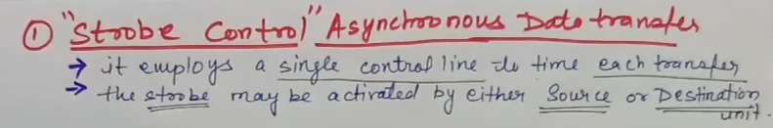
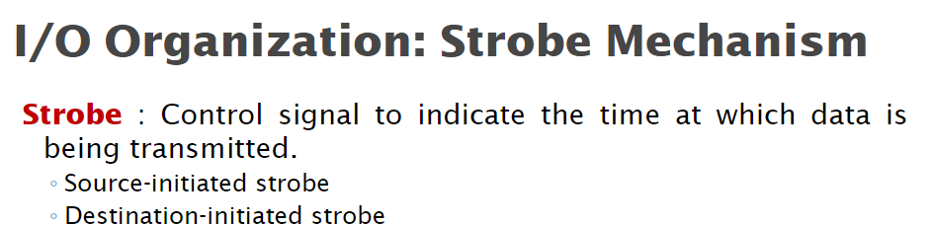

Slide 30
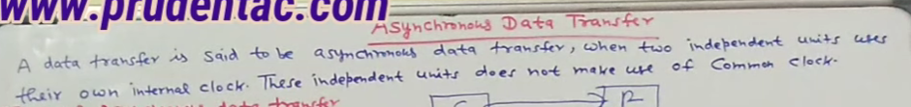
Cpu -> printer. Don’t know is recived

Slide 31
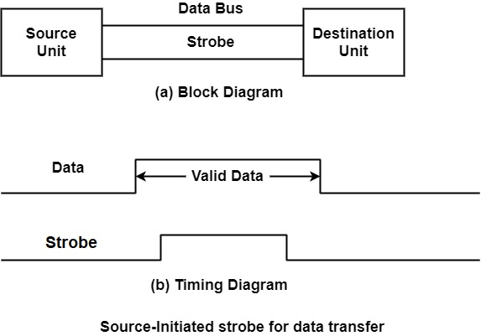

Slide 32
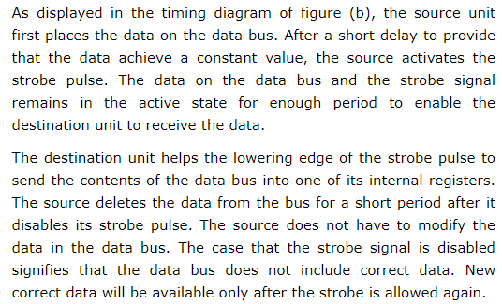

Slide 33
1.Data bus e data rakhse
2. Erpor control signal activated ami data pahachhi
3. Kichu second por strobe signal sorai nilo erpor data o sorai nilo without janlo ki destination data pailo ki pailo na, eta shudhu assume korche je paise

Slide 34
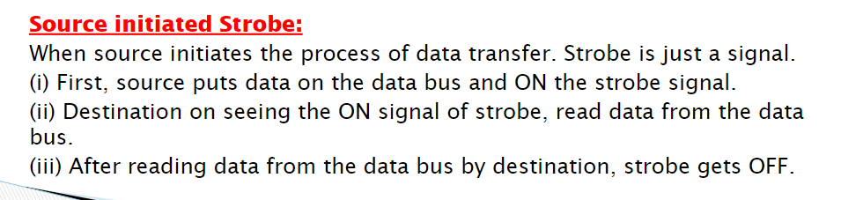

Slide 35
Prothom e source signal activate holo by destination
Kichu time por souce signal pele data rekhe dilo data bus e, jokhon e destination off kore dibe strobe /signal ,source o off kore or clear kore dibe data without knowing paise data source kina aar destination o assume korbe ey time e pathai dise source data

Slide 36
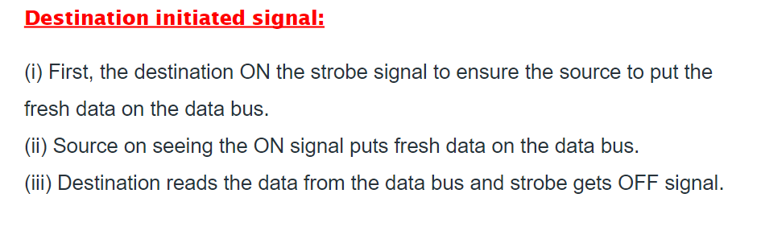

Slide 37
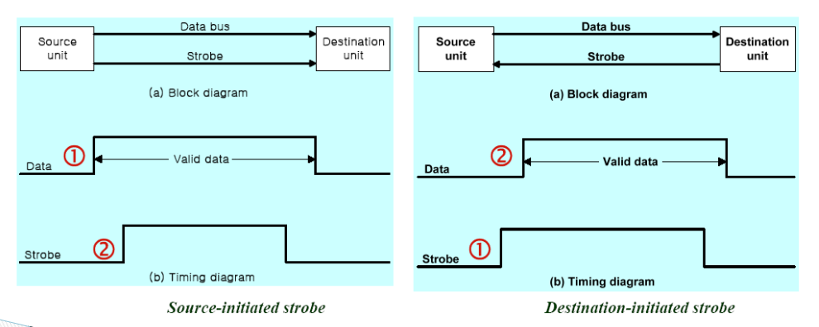

Slide 38
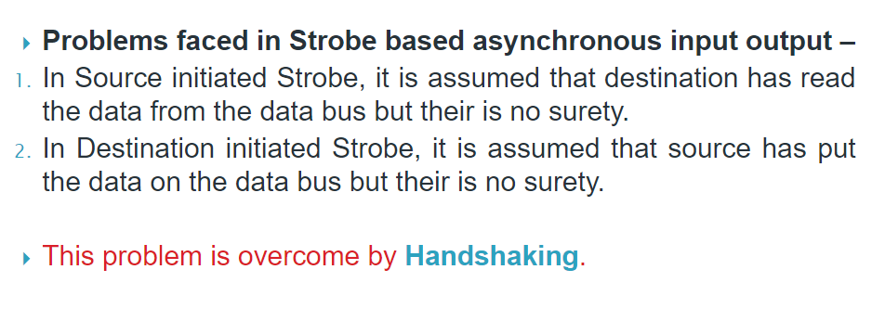

Slide 39
1.Source data bus e data rakhlo
2.Erpor dta valid ke activate korlo inform korar jonno je ami data pathacchi,
3.Epor data valid signal pele data receive kore data accepted signal pathabe
Jokhon source source accepted signal pele data bus theke data sorabe data valid ke deactivate korbe

Slide 40
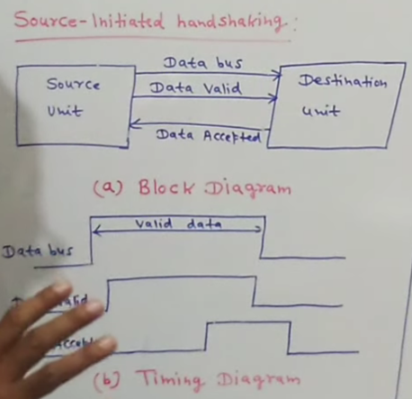

Slide 41
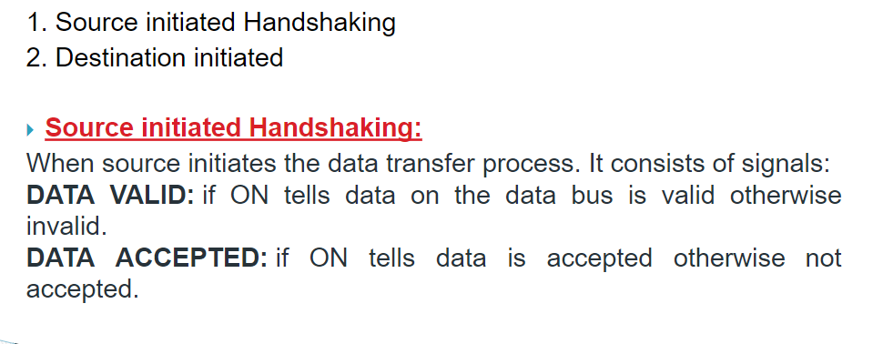

Slide 42
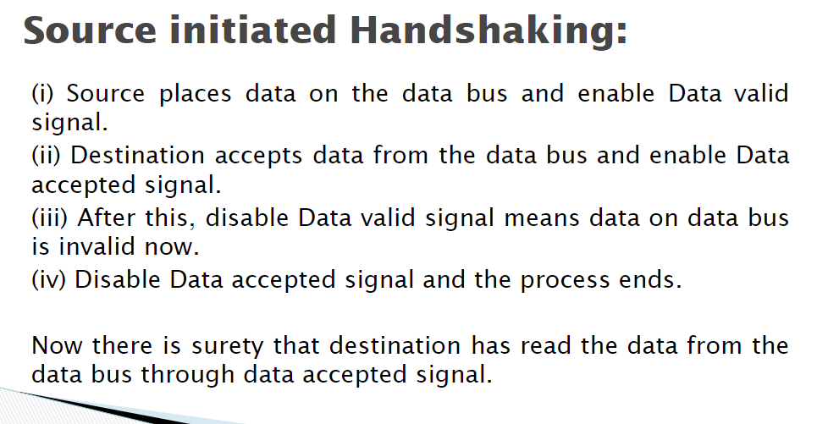

Slide 43
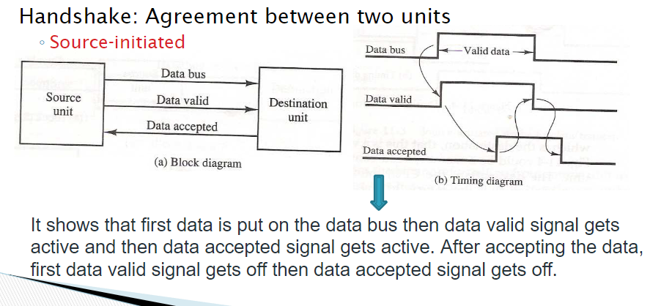

Slide 44
1.Destination Prothom e bollo ready for data
2. Ey signal source pele data bus e data rakhlo ar data valid ke activate korlo
3. Kichu time por destination data accept korlo
4. Erpor ready for data ke deactive korlo destination karon data peye gese
5.Dectivate hobar kichu por ek point e eshe source bujhlo deactivate hoise tokhon source data bus thele data sorabe aar data valid ke deactivate korbe

Slide 45
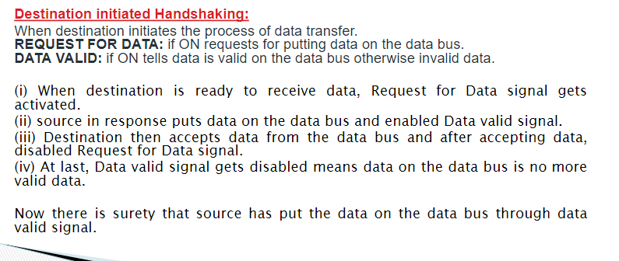

Slide 46
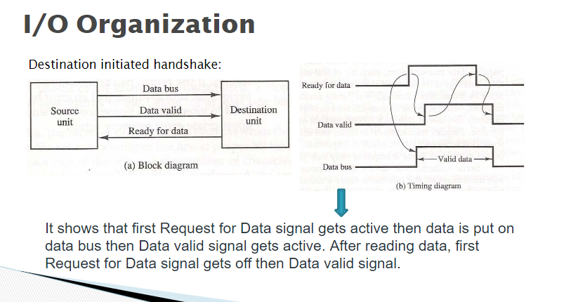

Slide 47


Slide 48


Slide 49



Slide 50



Slide 51


Slide 52


Slide 53


Slide 54


Slide 55


Slide 56


Slide 57





Slide 58


Slide 59




Slide 60


Slide 61





Slide 62


Slide 63



Slide 64


Slide 65




Slide 66


Slide 67


Slide 68


Slide 69


Slide 70



Slide 71


Slide 72


Slide 73


Slide 74


Slide 75


Slide 76


Slide 77




Slide 78


Slide 79


Slide 80


Slide 81


Slide 82


Slide 83


Slide 84


Slide 85


Slide 86


Slide 87


Slide 88


Slide 89


Slide 90



Slide 91


Slide 92


Slide 93


Slide 94


Slide 95


